Slide 1
Dreamland or real life
This poetry portfolio is dedicated to my teachers who have taught me knowledge or skills.
-------------Tom Xiao

Slide 2
Table of contents
4 Haiku ------------------------------------------------------- Page 1
Sensory Poem & Comic ----------------------------------- Page 2&3
Limerick ------------------------------------------------------ Page 4
Clerihew ------------------------------------------------------ Page 5
Alliteration Poem ------------------------------------------- Page 6
Metaphor Poem --------------------------------------------- Page 7
Concrete Poem ---------------------------------------------- Page 8

Slide 3
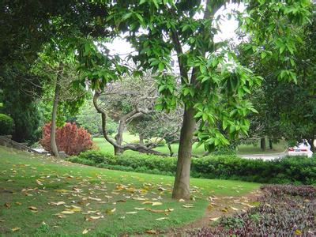
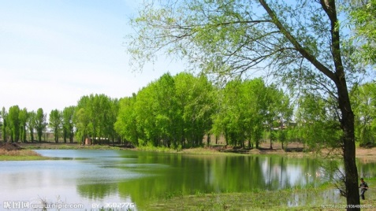
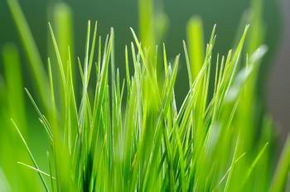
4 Haiku
Brown dark leaves fall down,
The young the green are growing,
Everything is new.
Grass never gives up.
The more strongly the winds blow,
The faster grass grows
Spring is coming now.
Many flowers and trees bloom,
Such as Magnolia.
Study is necessary.
Kids come back to school in spring,
For learning knowledge.

Slide 4
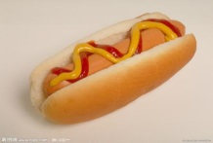
Sensory Poem
Love is bright red.
It takes like sweets and chocolates, And smells like the fragrance of a rose.
Love looks like hugs and kisses.
The sound of singing and dancing.
Love makes me feel nervous and shy.
(only this one has Comic)
Fun is colorful.
It tastes like coke and coffee,
And smells like hot-dogs and chips.
Fun looks like the stories in cartoons,
The sound of laughter.
Fun makes me feel excited and happy.

Slide 5
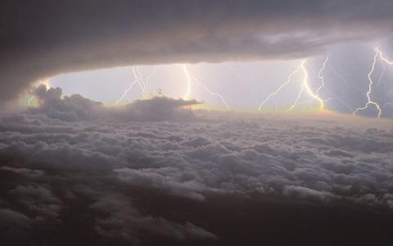
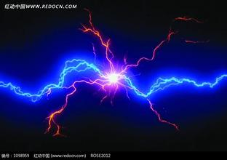
Limerick
There was a brave boy called Tom
Who once survived in a terrible “strom”
Rain, wind and lightning
Was very frightening
Want to know more? Come to Tom.com

Slide 6
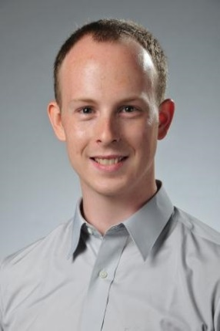
Clerihew
Why English teacher Mr. Manno closes the door?
Why some students do pushup on the floor?
Do students offend Mr. Manno?
No, cause Evil is Manno.

Slide 7
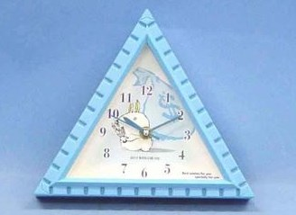
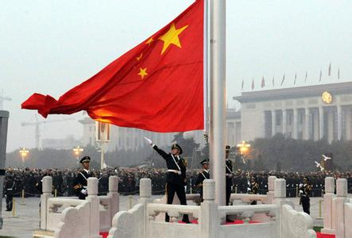
Alliteration Poem
There are three trees in the street on my way.
I think about the Triangle Theory among these trees.
Why they are not triple? Oh, thoughtful !!
Hey! Campus is here and let’s conceal our cell phones.
I change my chair, clean my cheek, open my computer and click my clause.
Oh, civics class! Oh, constitution! Oh, candidates! They cause me cry.
Wow! Monday morning! I don’t worry warning!
Wow! There must be a ceremony we are willing!
Wow! No time to study, no time to study! Welcoming!

Slide 8
Metaphor Poem
My life is like an airplane
Beginning with thunder
Moving to try my best
My life is like an airplane
Sometimes high and fast
Cloud and wind are under my feet
But I still have a dream until I die
Longing for flying into outer space
Trying though it can’t be true
My life is like an airplane.
I like the conflict with air and ATMOS
I like the quiet in the sky
They make me feel excited and peaceful
Why not try to fight?
It’s the most splendid period in whole life
I enjoy the feeling of conflict
My life is like an airplane
Having ups and downs
Jolt and accident
Trying to beat them up

Slide 9
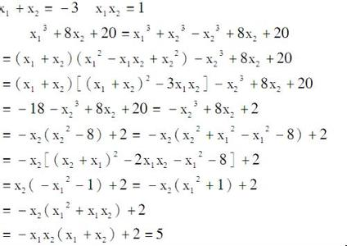
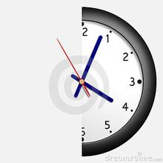
Concrete Poem
Tom is a clever boy I have
ever seen, one day, teacher
let him
to solve
the Math
problem.
Although
he was
sleeping
before
He solved
the Math problem
by only half an
hour. Oh Tom is
too too clever
to get an A score
What a pity!
Don’t worry
Tom will even not care
about it until the final
score comes out.
“Don’t worry there
are still some time”
Said by Tom

